Slide 1
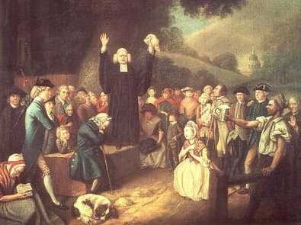
The Great Awakening
The Great Awakening was a religious movement during the 1730s and 1740s in which colonial preachers presented powerful sermons or messages of salvation (the act of delivering from sin or saving from evil).

Slide 2
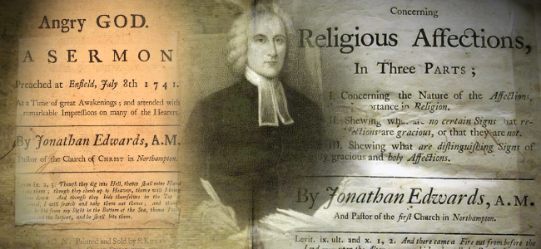
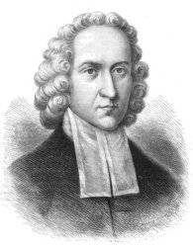
Jonathan Edwards, a preacher and Pilgrim, began the movement in Massachusetts.

Slide 3
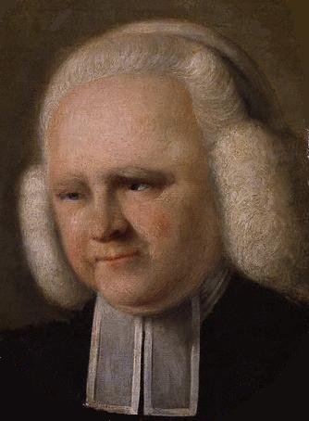
The English preacher, George Whitefield continued the movement, traveling across the colonies and preaching in a dramatic and emotional style, accepting Christians as his audience.

