Slide 1
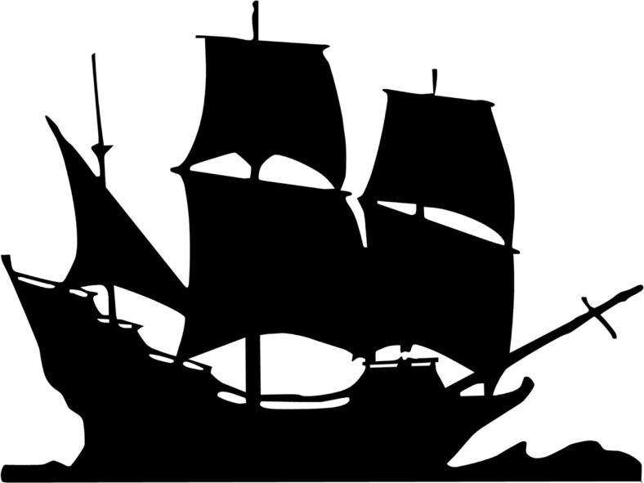
Triangular Trade and Mercantilism

Slide 3
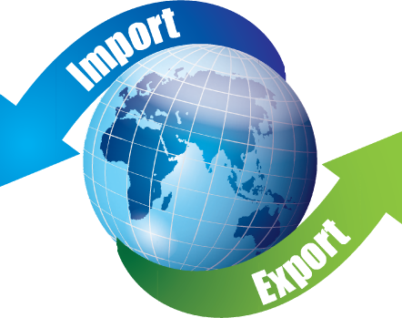
Triangular Trade
Import-goods and services that consumers in one country buy from producers in another country
Export-goods or services produced in one nation by sold to buyers in another nation

Slide 4
The first leg of the voyage often started in an English port. Ships were loaded with goods to take to Africa to trade for slaves. The second leg-often called the “dreaded Middle Passage”-carried the slaves who had been purchased or captured from Africa to the slave markets of the New World. For the third leg, ships full of sugar, tobacco, and other products from the Americas (and from the Caribbean Islands) traveled to the English ports. Of course, there were problems, especially on the Middle Passage leg of the journey. Other ships might attack them and take the load of captive slaves to sell for themselves. Sometimes slaves rebelled or illness erupted and decimated the slaves and the crew.

Slide 5
Where:
Imported:
Exported:
Where:
Imported:
Exported:
Where:
Imported:
Exported:
Atlantic Ocean

Slide 6
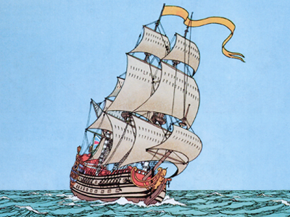
Triangular Trade Interactive Map

Slide 7
Mercantilism
An economic system based on trade. A powerful country (called a mother country) conquers some other land to get natural resources from there (like raw materials, gold, silver, and food). This land is called a “colony” because it is owned by the mother country. The mother country takes the natural resources back to its homeland and has workers use the resources to make manufactured goods (like using a tree to make furniture, silver to make forks and knives, and cotton to make clothing). The mother country then sells these manufactured goods (like furniture, forks and knives, and clothing) for a higher price than they paid.

Slide 8
The Triangular Trade is an example of mercantilism, or the idea that the mother country gains wealth and power by controlling the trade of its colonies. By taking products from America and then either creating manufactured goods or selling the original products to other countries (foreign markets), England was able to profit from the wealth of goods found in America. American merchants would not be able to deal with another country directly, but would have to operate within the rules that the English government established for them.

Slide 9
